Slide 1
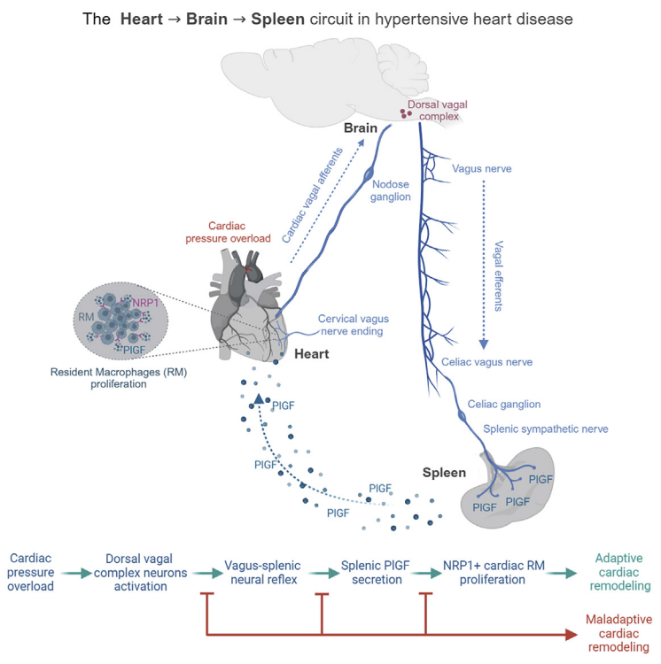
Result Flow
R2
The LV establishes a neural circuit with the dorsal vagal complex in the brain
Pressure overload induces LV adaptive remodeling and macrophage expansion
R1
Pressure overload recruits a vagus nerve-mediated brain-to-spleen circuit
R3
SA1: To define the heart–brain–spleen neural circuit activated by cardiac pressure overload by mapping vagal afferent signaling to the brainstem and its downstream engagement of splenic sympathetic output.

Slide 2
Result Flow
SA2: To delineate how splenic signaling regulates cardiac resident macrophage dynamics by identifying PlGF–NRP1–dependent proliferation of resident macrophages
NRP1 identifies cardiac macrophages essential for adaptive hypertrophy during hypertensive stress
R7
RMs proliferate in response to cardiac stress and are necessary to hamper HF
R5
R6
SNS-mediated PlGF release connects the spleen to the pressure-overloaded heart
R4
The spleen protects from HTN-HD development

Slide 3
Result Flow
SA3: To determine the functional and translational relevance of the PIGF-NRP1-cardiac macrophage axis by assessing its role in adaptive cardiac remodeling, fibrosis, and heart failure progression in both mouse models and humans.
R9
PlGF correlates with hypertension, and NRP1+ RMs are conserved in human HF
R8
Neural-mediated PlGF-NRP1 signaling in profibrotic cardiac RMs promotes adaptive hypertrophy

